Slide 1
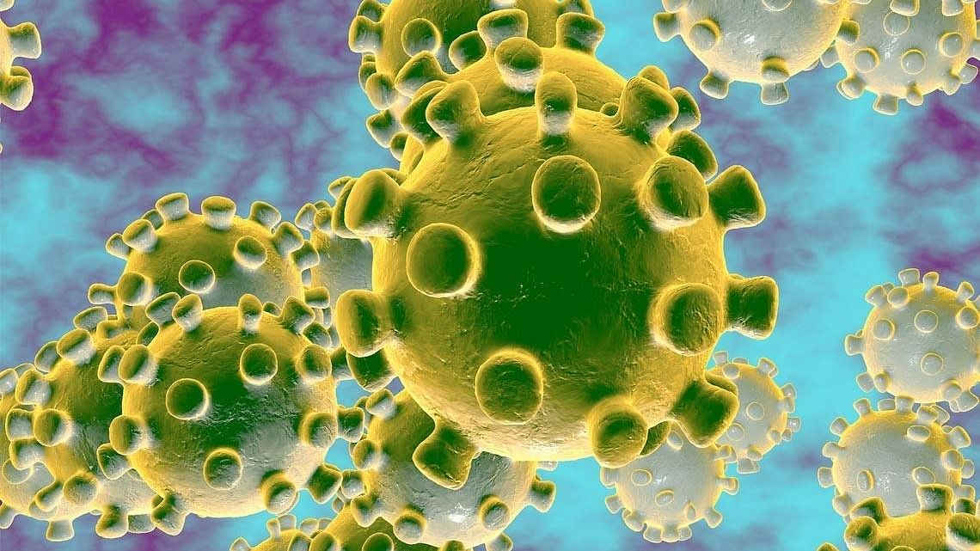
Major Project
COVID-19 Data
Submitted by: RASHMI
H12096

Slide 2
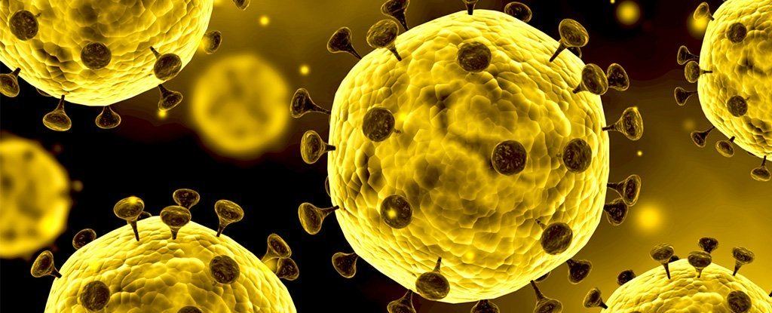
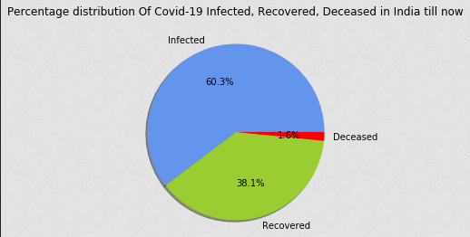
Pie Chart shows the percentage distribution between confirmed, cured and deaths of people in India due to COVID-19

Slide 3
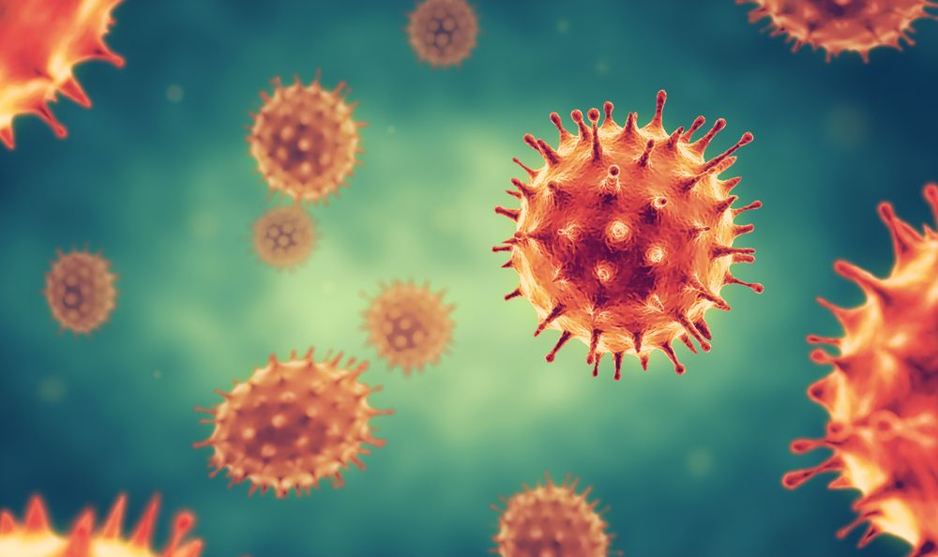
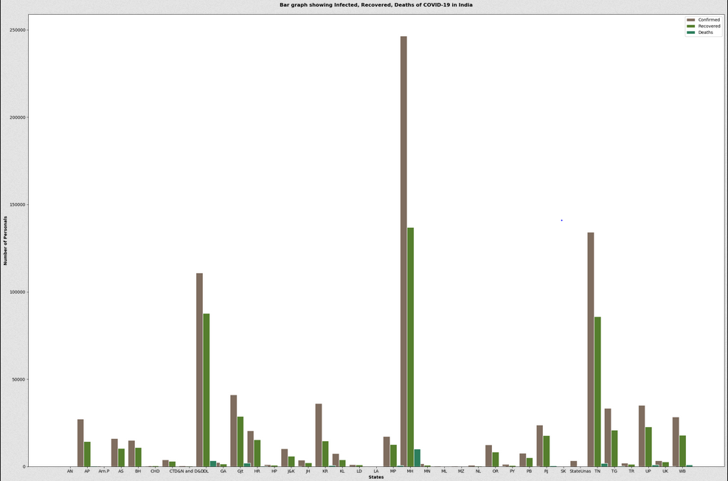
Bar graph shows Confirmed, Cured and Deceased Cases in all State/UTs of India

Slide 4
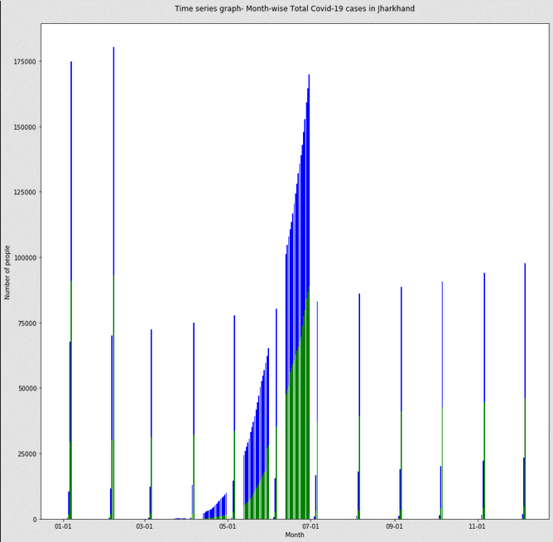
Time series graph of Infected, Cured and Deceased cases due to COVID-19 in Jharkhand State

Slide 5
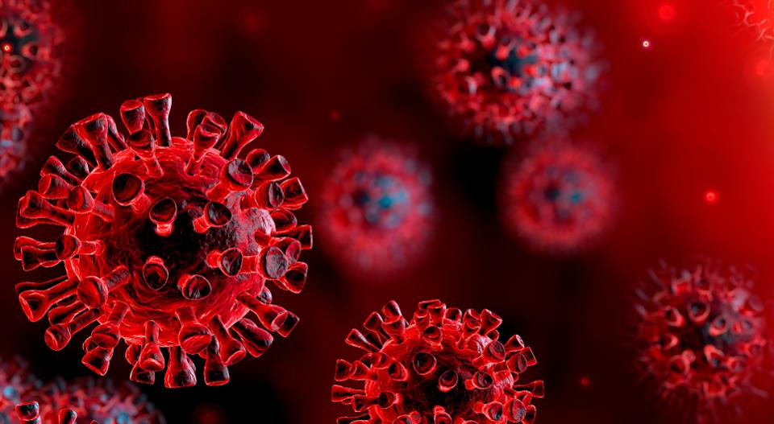
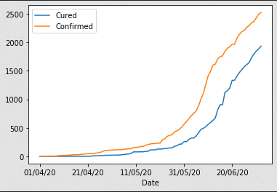
Graph shows relation between Infected and Cured personals of Jharkhand State till now

Slide 6
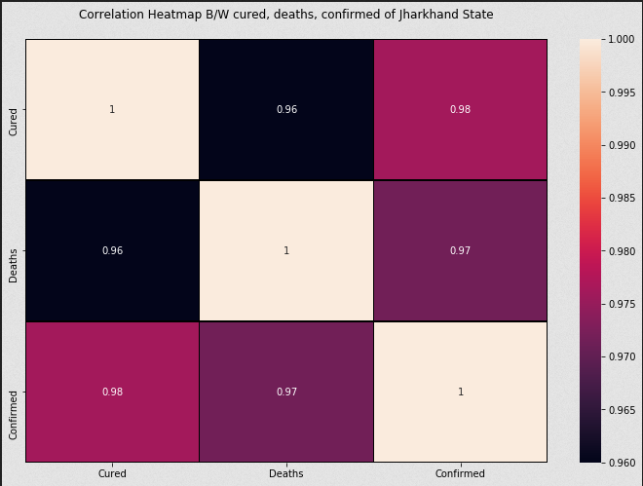
Correlation between Confirmed, Cured and Death of Personals in Jharkhand State due to COVID-19

